Slide 1
Bob Marley
Poetry Analysis

Slide 3
Background (Early Life)
Bob Marley was born Robert Nesta Marley on February 6, 1945. Bob's early life was spent in rural community of Nine Miles, nestled in the mountainous terrain of the parish of St. Ann. Norval and Cedella married in 1945 but Captain Marley's family strongly disapproved of their union; although the elder Marley provided financial support, the last time Bob Marley saw his father was when he was five years old; at that time, Norval took his son to Kingston to live with his nephew, a businessman, and to attend school. Eighteen months later Cedella learned that Bob wasn't going to school and was living with an elderly couple. Alarmed, she went to Kingston, found Bob and brought him home to Nine Miles.

Slide 4
The Start of Music (Background)
In the late 1950’s Bob Marley left St.Ann’s and settled in Kingston. At 16 years old Bob Marley met another aspiring singer named Desmond Dekker, who later on introduced him to another young singer, Jimmy Cliff. In 1962 Cliff introduced Marley to producer Leslie Kong; Marley cut his first singles for Kong: "Judge Not", "Terror" and "One More Cup of Coffee", a cover of the million selling country hit by Claude Gray. When these songs failed to connect with the public, Marley was paid a mere $20.00, an exploitative practice that was widespread during the infancy of Jamaica's music business. Bob Marley reportedly told Kong he would make a lot of money from his recordings one day but he would never be able to enjoy it.

Slide 5
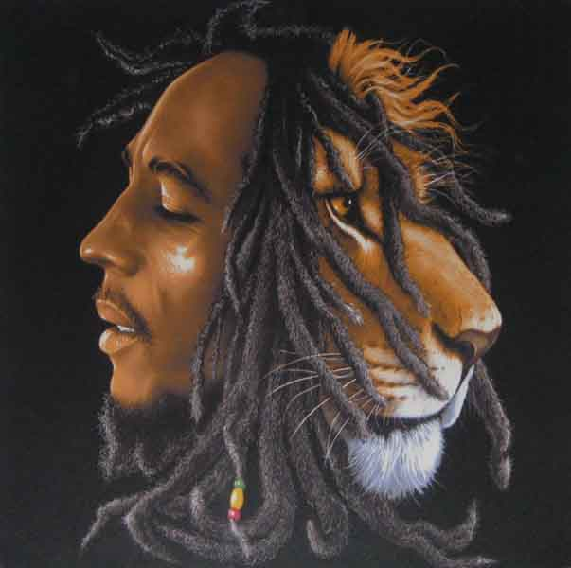
Rastafari
The pan-African consciousness, progressive political ideologies and deep spiritual convictions heard in Bob Marley's music were derived from his firmly rooted commitment to Rastafarian beliefs.

Slide 6
Exodus
Exodus: Movement of Jah people! Oh-oh-oh, yea-eah!
Men and people will fight ya down (Tell me why!) When ya see Jah light. (Ha-ha-ha-ha-ha-ha-ha!) Let me tell you if you're not wrong; (Then, why?) Everything is all right. So we gonna walk - all right! - through de roads of creation: We the generation (Tell me why!) (Trod through great tribulation) trod through great tribulation.
Exodus, all right! Movement of Jah people!
Oh, yeah! O-oo, yeah! All right! Exodus: Movement of Jah people! Oh, yeah!
Yeah-yeah-yeah, well! Uh! Open your eyes and look within: Are you satisfied (with the life you're living)? Huh! We know where we're going, uh! We know where we're from. We're leaving Babylon, We're going to our Father's land. 2, 3, 4: Exodus: movement of Jah people! Oh, yeah! (Movement of Jah people!) Send us another brother Moses! (Movement of Jah people!) From across the Red Sea! (Movement of Jah people!) Send us another brother Moses! (Movement of Jah people!) From across the Red Sea! (Movement of Jah people!) ---Exodus, all right! Oo-oo-ooh! Oo-ooh! Movement of Jah people! Oh, yeah! Exodus! Exodus! All right! Exodus! Now, now, now, now! Exodus! Oh, yea-ea-ea-ea-ea-ea-eah! Exodus! All right! Exodus! Uh-uh-uh-uh!
Move! Move! Move! Move! Move! Move!zq
Open your eyes and look within: Are you satisfied with the life you're living? We know where we're going; We know where we're from. We're leaving Babylon, y'all! We're going to our Father's land.
Exodus, all right! Movement of Jah people! Exodus: movement of Jah people! Movement of Jah people(3x)
Move! Move! Move! Move! Move! Move! Move!
Jah come to break downpression, Rule equality, Wipe away transgression, Set the captives free! Exodus, all right, all right! Movement of Jah people! Oh, yeah! Exodus: movement of Jah people! Oh, now, now, now, now! Movement of Jah people! Movement of Jah people! Movement of Jah people! Movement of Jah people! Movement of Jah people! Movement of Jah people!
Move! Move! Move! Move! Move! Move! Uh-uh-uh-uh! Movement of Jah people!
Movement of Jah people!
Movement of Jah people!
Movement of Jah people! Movement of Jah people! Movement of Jah people!(4x)

Slide 7
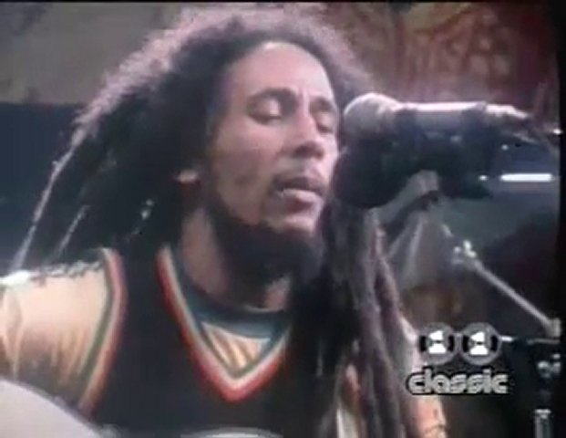
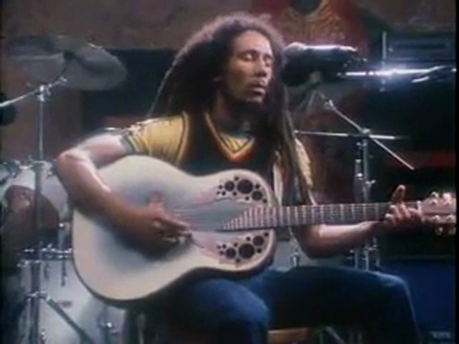
Redemption Song
Old pirates, yes, they rob I Sold I to the merchant ships Minutes after they took I From the bottomless pit But my hand was made strong By the 'and of the Almighty We forward in this generation Triumphantly
[Hook] Won't you help to sing These songs of freedom? Cause all I ever have Redemption songs
[Verse 2] Emancipate yourselves from mental slavery None but ourselves can free our minds! Have no fear for atomic energy Cause none of them can stop the time How long shall they kill our prophets While we stand aside and look? Some say it's just a part of it We've got to fullfil the book

Slide 8
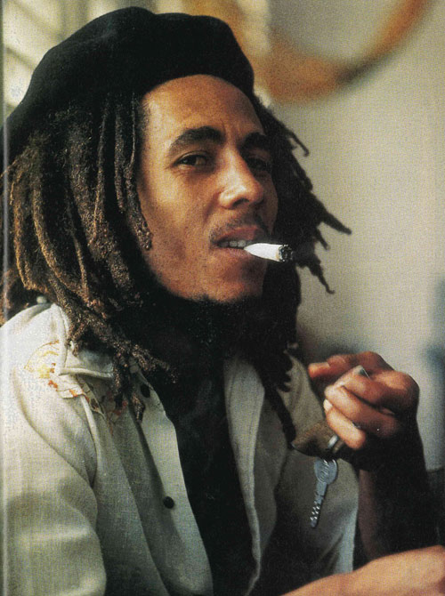
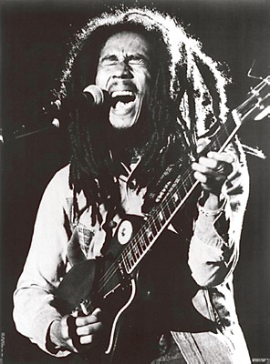
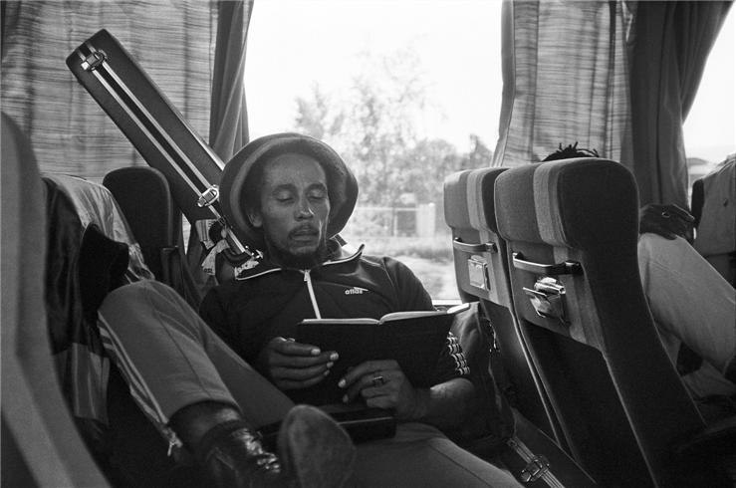
Bob Marley
Positivity
Bettering yourself
Knowing what really matters in the world.

