Slide 1
Cuba
Folami mack

Slide 2
Full name: Republic of Cuba
Population: 11.2 million (UN, 2011)
Capital: Havana
Area: 110,860 sq km (42,803 sq miles)

Slide 3
History
British
Spain
United States

Slide 4
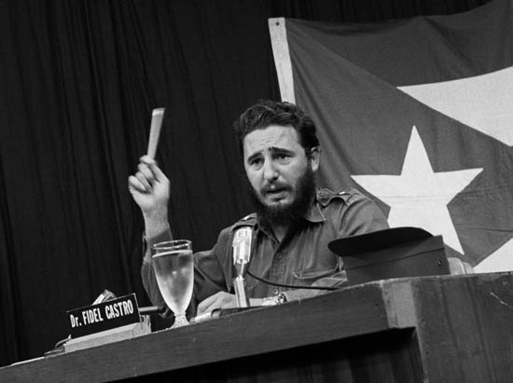
Fidel Castro
https://www.youtube.com/watch?v=ZW_EaUN080Y

Slide 5
Business
GDP: 68.23 billion USD
Agriculture: 3.8%
Industry: 22.3%
Services: 73.9%

Slide 6
Labor Force
Agriculture: 19.7%
Industry: 17.1%
Services: 63.2%
Unemployment rate: 4.3% (2013 est.)

Slide 7
Business
Agriculture : sugar, tobacco, citrus, coffee, rice, potatoes, beans; livestock
Industries: petroleum, nickel, cobalt, pharmaceuticals, tobacco, construction, steel, cement, agricultural machinery, sugar
Services : Medical

Slide 8
- Meetings - Time Management - Entertainment
Business

Slide 9
Communication
Verbal
Family
Politics
Persuasiveness
Nonverbal
Personal Space
Greetings
Eye Contact

Slide 10
Languages
Spanish
Creole
Lucumi

Slide 11
Education
Level Of Education | Grade Level
Primary | 1st – 6th
Secondary - Basic Secondary - Technical Secondary | 7th – 9th
Vocational | 3 Years
Tertiary | Varies

Slide 12
Literacy Rate
total population: 99.8% male: 99.8% female: 99.8%

Slide 13
Holidays
January 1st : Liberation Day
July 18 to 27: Santiago De Cuba
Good Friday
December 25th : Christmas

Slide 14
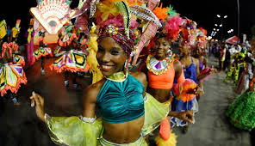
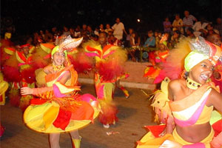

Slide 15
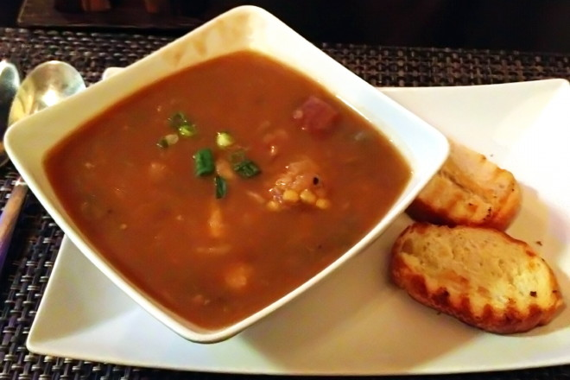
Food
Moors and Christians (Black Beans and Rice)
Fried Plantains
Ajiaco

