Slide 1
Festival Comparison
Folami Mack
Per. 6

Slide 2
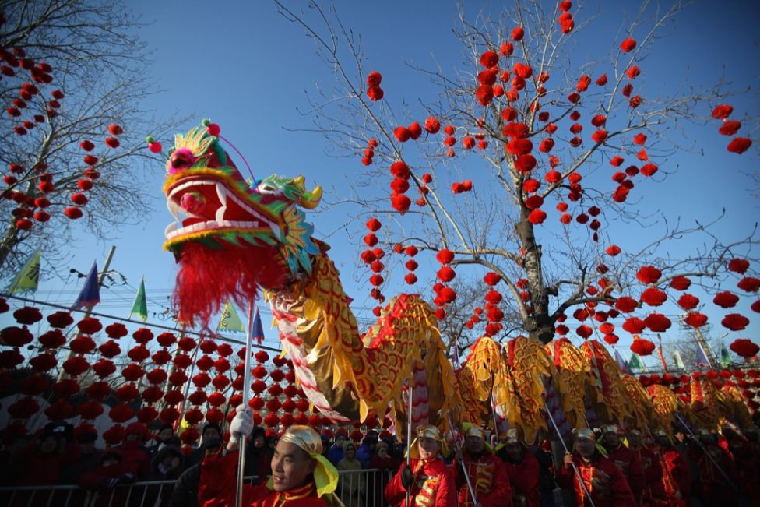
Chinese New Year Festival

Slide 3
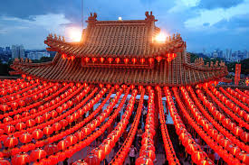
Meaning
Celebration of the new Chinese Year
Based on a traditional Chinese lunisolar calendar
One of the most important of the holidays for the Chinese.

Slide 4
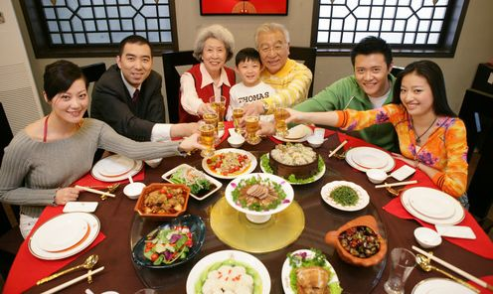
Traditions
Cleaning
Decoration
Red envelope
Fireworks
New Year's Eve Dinner

Slide 5
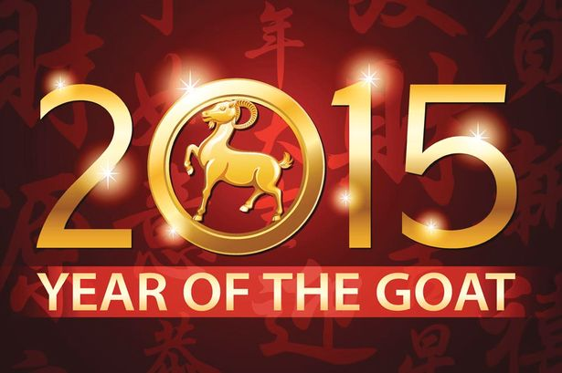
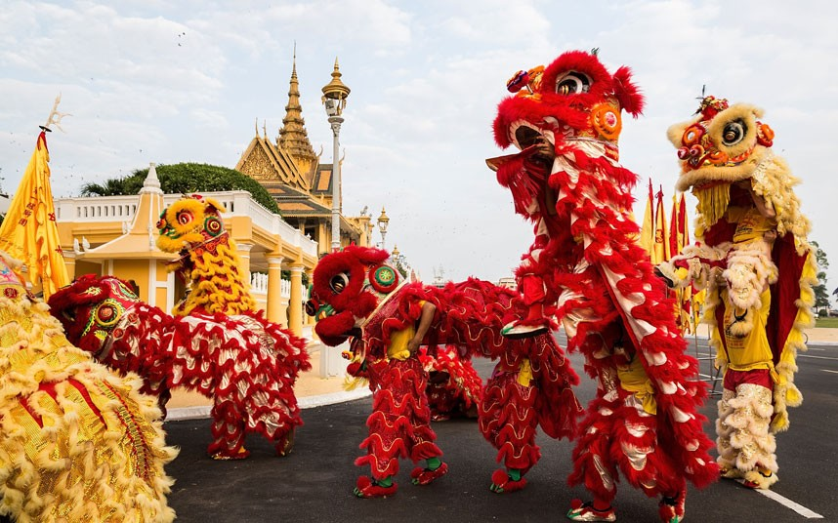
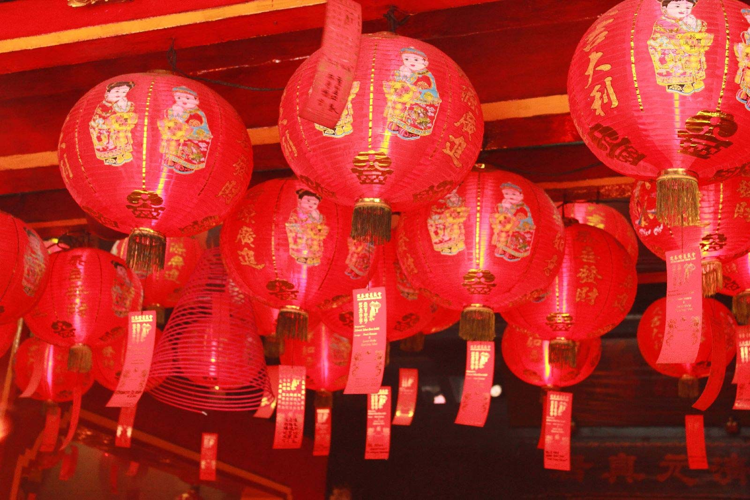

Slide 7
Meaning
To give people a glimpse into all types of cultures.
Intends to educate people and expand their global contempacy.

Slide 8
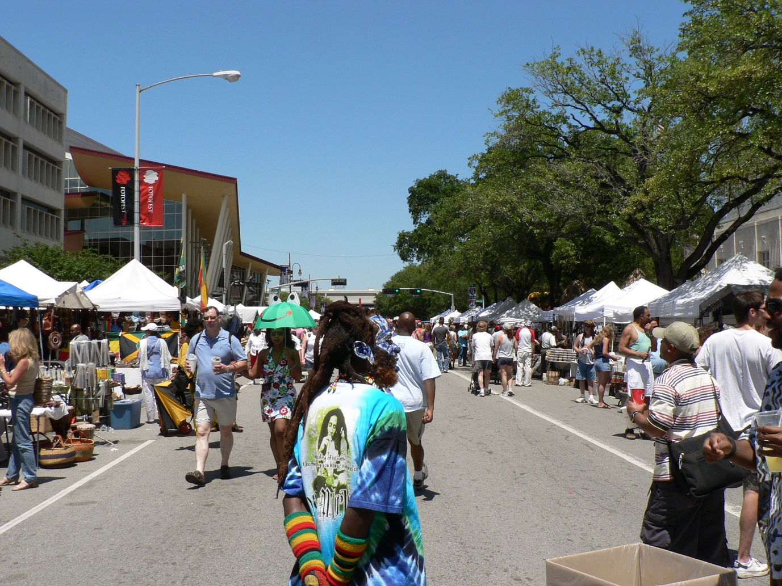
Traditions
Music/Concert
Food
Markets

Slide 9
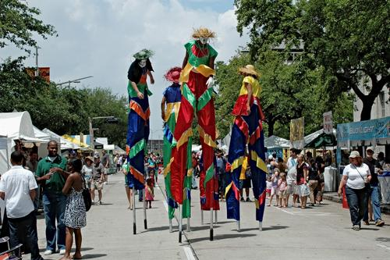
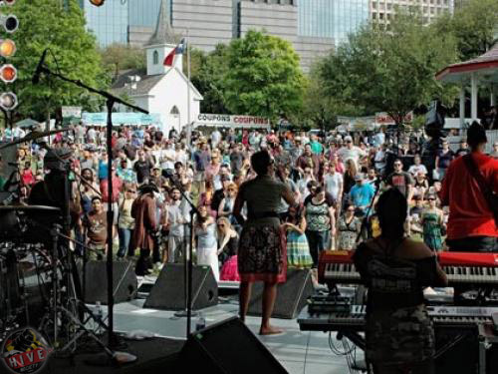
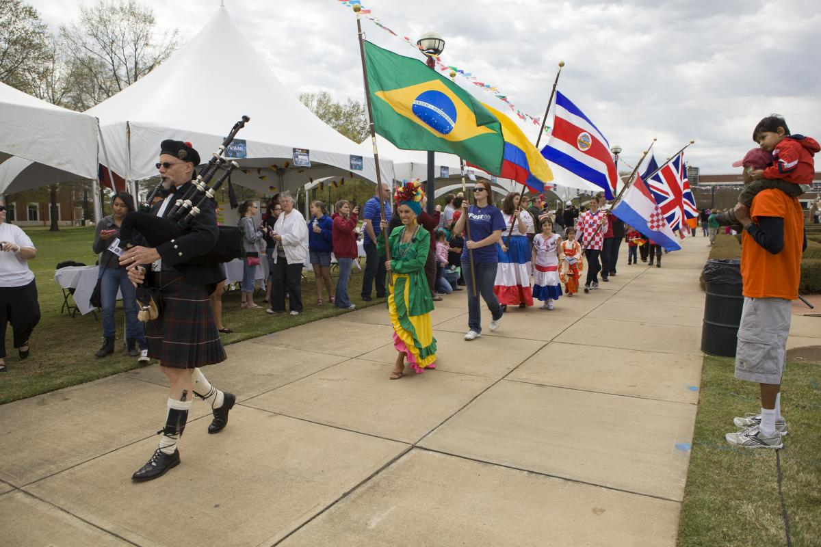
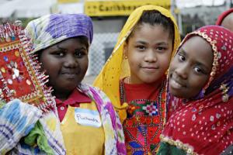

Slide 10
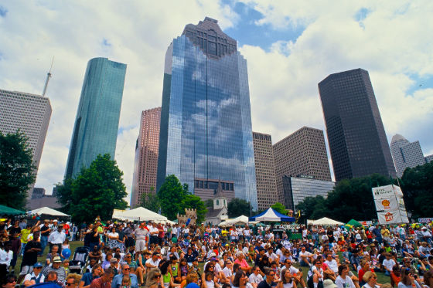

Slide 11
Similarities
Popularity
Purpose
Education/Influence

Slide 12
Differences
Culture
Tradition

Slide 13
Thank You

